Slide 1




“A place for a moment of clarity in your life”
Presented by: Christian A. Martinez
JAVA Object-Oriented Programming
UTRGV // Fall 2019

Slide 2
Introduction

Slide 3


App Concept and Background
Create an app that generates quotes depending on the category selected.
Age Range: 5+ years
User-friendly
Easy-to-Browse
Social Media Style Viewing
Figure 1: App Logo
Figure 2: App Title

Slide 4



Top 3 Competitors
(Top 3 searches when typed “Quotes” on Google Play Store)
Daily Motivational Quotes App Best Quotes and Status Motivational Quotes

Slide 5
2. Concept and Building

Slide 6
Goals and Expectations
Code/Program
Generate Random Quote from a database (.txt)
Create 1 database from 6 topical quotes
Database be constructed using HashTables<String>
Program is adaptable to more text files (More Quotes)
App Development
Display at least 6 different categories
Each category has at least 5-10 quotes with an image that represents the topic
User-friendly with social media elements
Can return back to Main Menu

Slide 7
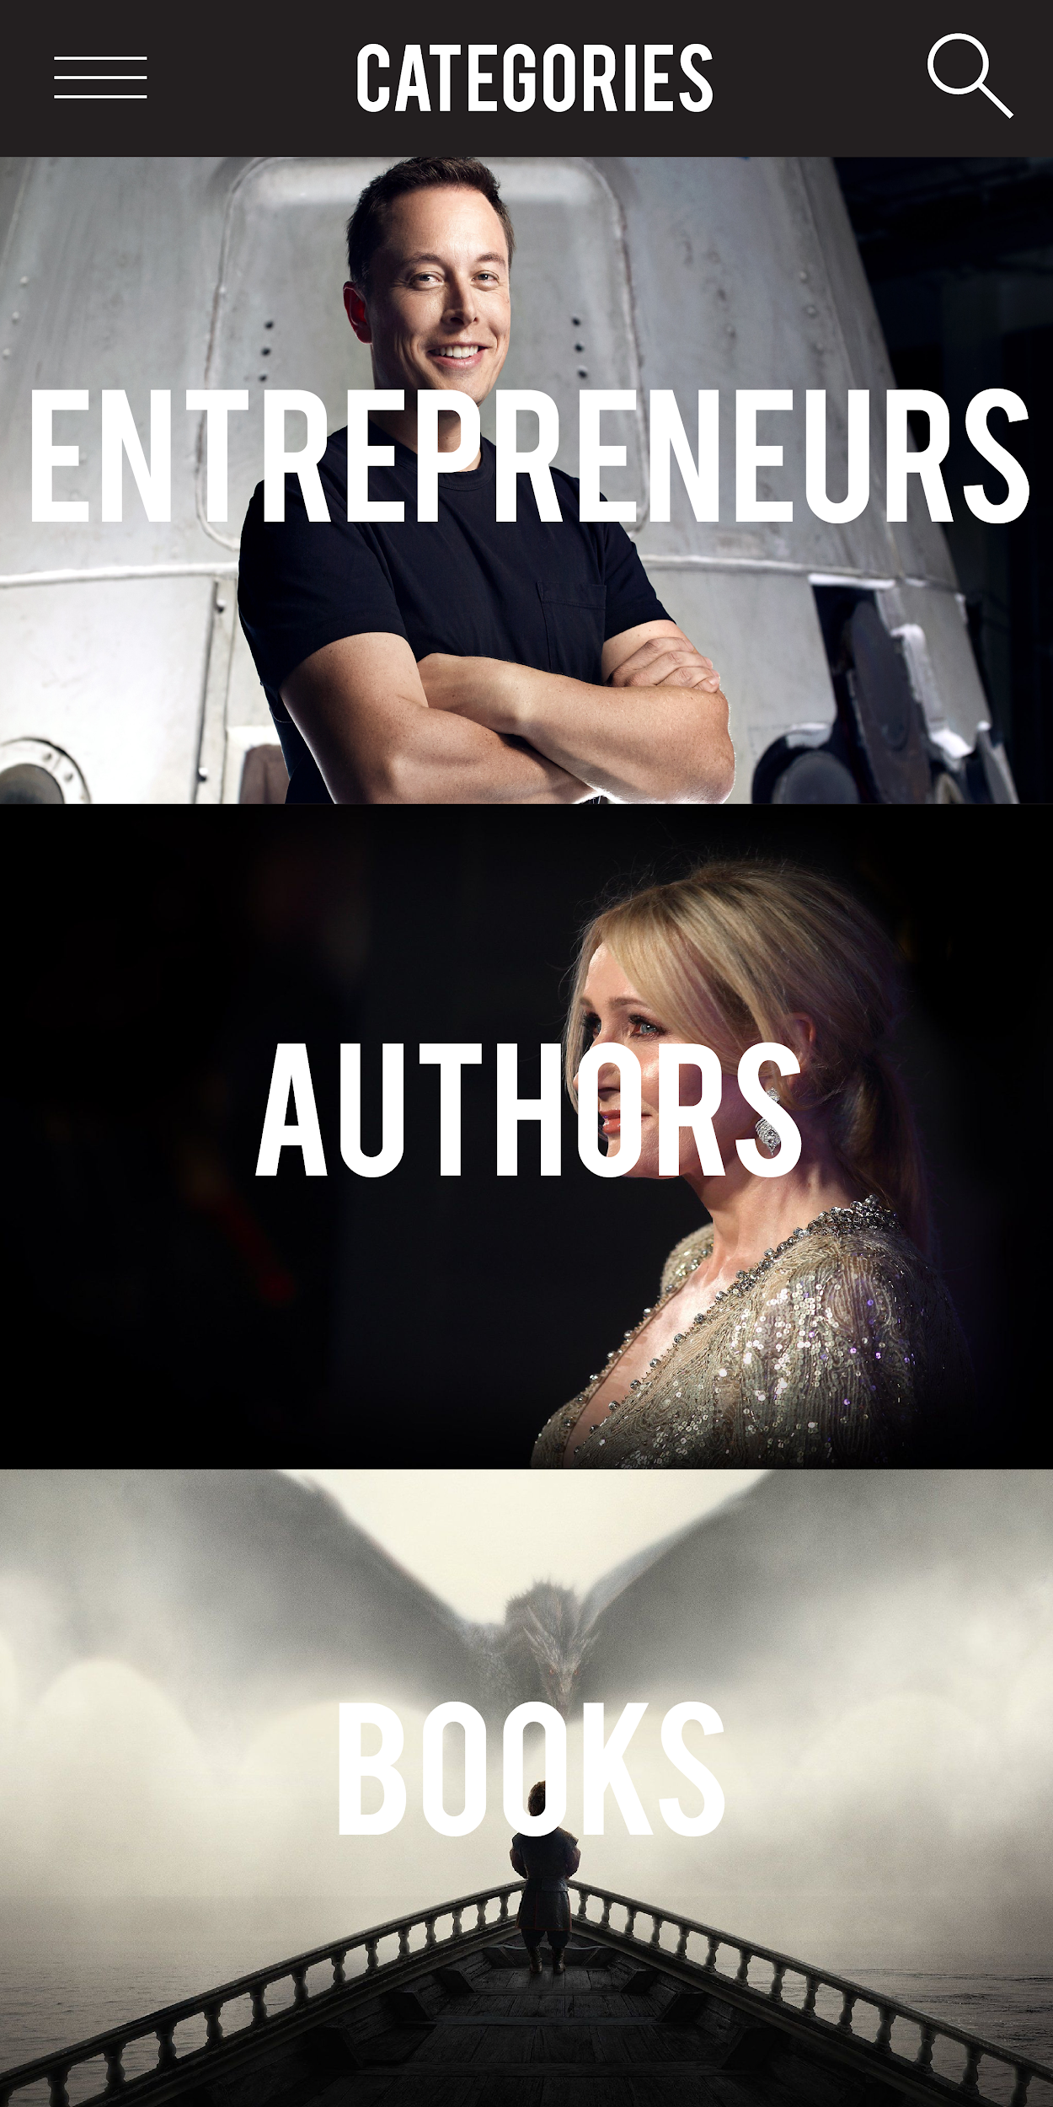


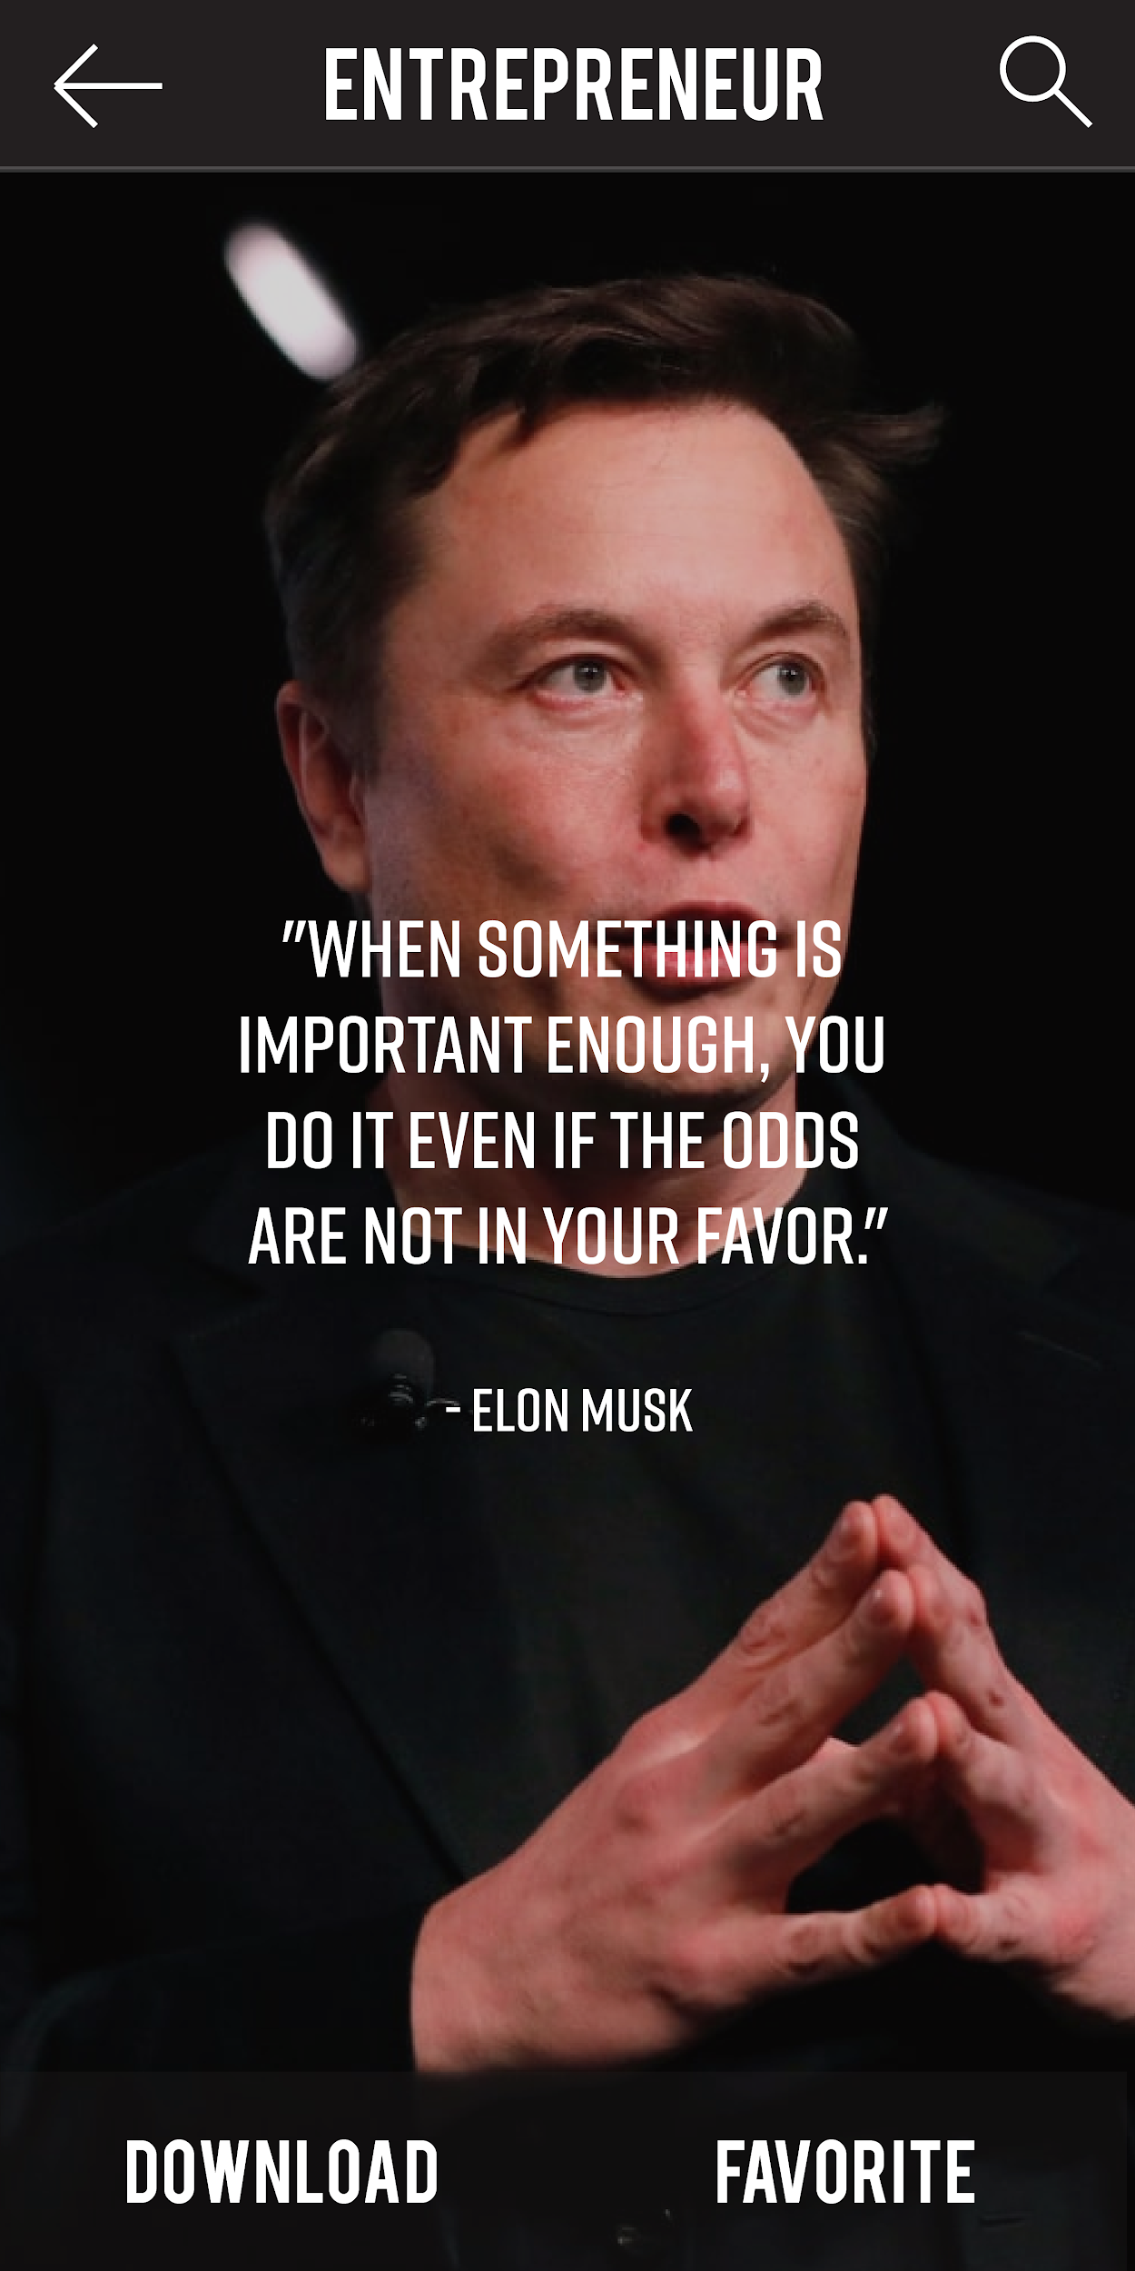
App Concept & Future Expectation
Made on Adobe Illustrator

Slide 8



Required Software

Slide 9
Demo

Slide 10
Conclusion
Questions?
Comments?
Concerns?

Slide 11
Thank You!

Slide 12
References
https://www.youtube.com/watch?v=VX5nxFwAQ-M - Image button
https://www.youtube.com/watch?v=zHxmSmjOSco - New Activity
https://stackoverflow.com/questions/8631985/how-to-create-a-new-activity-and-then-display-text-in-it-with-android-programmin - New Activity
https://www.geeksforgeeks.org/hashtable-in-java/ - Hashtable
https://developer.android.com/reference/android/widget/ImageView - Android Studio ImageView

